Slide 1



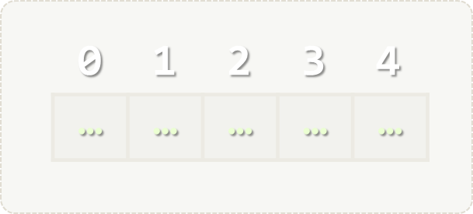
Arrays
Simple Array Processing
Arrays
SoftUni Team
Technical Trainers
Software University
http://softuni.bg

Slide 2

Table of Contents
Defining, Initializing and Processing Arrays
Value vs Reference Types
Reading and Printing Arrays

Slide 3
Questions?
sli.do #tech-softuni

Slide 4
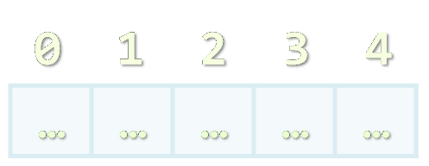
Arrays
Working with Arrays of Elements

Slide 5
What are Arrays?
In programming, array is a sequence of elements
Elements are numbered from 0 to Length-1
Elements are of the same type (e.g. integers)
Arrays have fixed size (Array.Length) – cannot be resized
0 1 2 3 4
Element index
Array of 5 elements
… | … | … | … | …
Element of an array

Slide 6
Working with Arrays
All elements are initially == 0
Allocating an array of 10 integers:
Assigning values to the array elements:
Accessing array elements by index:
int[] numbers = new int[10];
The Length holds the number of array elements
for (int i = 0; i < numbers.Length; i++)
numbers[i] = 1;
The [] operator accesses elements by index
numbers[5] = numbers[2] + numbers[7];
numbers[10] = 1; // IndexOutOfRangeException

Slide 7
Days of Week – Example
The days of week can be stored in array of strings:
string[] days = {
"Monday",
"Tuesday",
"Wednesday",
"Thursday",
"Friday",
"Saturday",
"Sunday"
};
Expression | Value
days[0] | Monday
days[1] | Tuesday
days[2] | Wednesday
days[3] | Thursday
days[4] | Friday
days[5] | Saturday
days[6] | Sunday

Slide 8
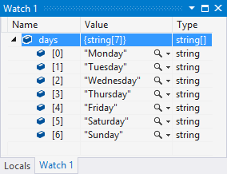
Problem: Day of Week
Enter a day number [1…7] and print the day name (in English) or "Invalid day!"
Check your solution here: https://judge.softuni.bg/Contests/Practice/Index/172#0

Slide 9
Solution: Day of Week
string[] days = { "Monday", "Tuesday", "Wednesday", "Thursday", "Friday", "Saturday", "Sunday" };
int day = int.Parse(Console.ReadLine());
if (day >= 1 && day <= 7)
Console.WriteLine(days[day - 1]);
else
Console.WriteLine("Invalid day!");
Check your solution here: https://judge.softuni.bg/Contests/Practice/Index/172#0

Slide 10
Value vs Reference Types
Memory Stack and Heap

Slide 11
Value types
List of Value Types - https://msdn.microsoft.com/en-us/library/bfft1t3c.aspx
Variables of value types directly contain their data.
With value types, each variable has its own copy of the data, and it is not possible for operations on one variable to affect the other

Slide 12
Reference types
Some of the reference types – string, DateTime, TimeSpan, Random, any other classes, interfaces, delegates and more.
Variables of reference types store references to their data.
With reference types, two variables can reference the same object; therefore, operations on one variable can affect the object referenced by the other variable.

Slide 13
Value vs Reference Types

Slide 14
Example: Value Types
public static void Main(string[] args)
{
int num = 5;
Increment(num, 15);
Console.WriteLine(num);
}
private static void Increment(int num, int value)
{
num += value;
}
num == 5
num == 20

Slide 15
Example: Reference Types
public static void Main(string[] args)
{
int[] nums = { 5 };
Increment(nums, 15);
Console.WriteLine(nums[0]);
}
private static void Increment(int[] nums, int value)
{
nums[0] += value;
}
num == 20
num == 20

Slide 16

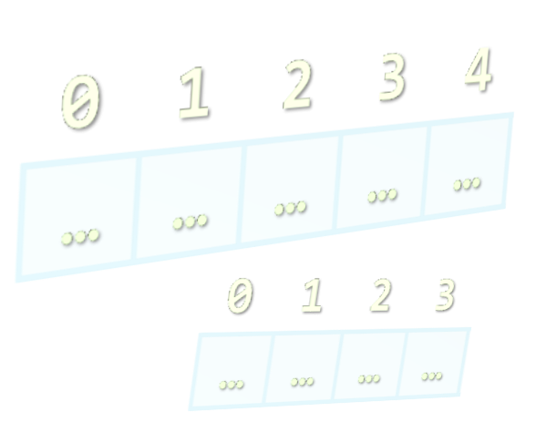
Reading Arrays from the Console
Using for loop or String.Split()

Slide 17
Reading Arrays From the Console
First, read from the console the array length:
Next, create an array of given size n and read its elements:
int n = int.Parse(Console.ReadLine());
int[] arr = new int[n];
for (int i = 0; i < n; i++)
{
arr[i] = int.Parse(Console.ReadLine());
}

Slide 18
Reading Array Values from a Single Line
Arrays can be read from a single line of space separated values:
2 8 30 25 40 72 -2 44 56
.Split(' ') splits by space into string[]
string values = Console.ReadLine();
string[] items = values.Split(' ');
int[] arr = new int[items.Length];
for (int i = 0; i < items.Length; i++)
arr[i] = int.Parse(items[i]);

Slide 19
Printing Arrays on the Console
To print all array elements, a for-loop can be used
Separate elements with white space or a new line
Example:
string[] arr = {"one", "two", "three", "four", "five"};
// Process all array elements
for (int index = 0; index < arr.Length; index++)
{
// Print each element on a separate line
Console.WriteLine("arr[{0}] = {1}", index, arr[index]);
}

Slide 20
Problem: Reverse an Array of Integers
Read an array of integers (a number n + n lines of integers), reverse it and print its elements (on a single line, space separated):
3
10
20
30
30 20 10
4
-1
20
99
5
5 99 20 -1
Check your solution here: https://judge.softuni.bg/Contests/Practice/Index/172#1

Slide 21
Solution: Reverse an Array of Integers
// Read the array (a number n + n lines of integers)
var n = int.Parse(Console.ReadLine());
var arr = new int[n];
for (int i = 0; i < n; i++)
arr[i] = int.Parse(Console.ReadLine());
// Print the elements from the last to the first
for (int i = n-1; i >= 0; i--)
Console.Write(arr[i] + " ");
Console.WriteLine();
Check your solution here: https://judge.softuni.bg/Contests/Practice/Index/172#1

Slide 22
Problem: Rounding Numbers
Read an array of real numbers (space separated values), round them in "away from 0" style and print the output as in the examples:
0.9 1.5 2.4 2.5 3.14
-5.01 -1.599 -2.5 -1.50 0
0.9 => 1
1.5 => 2
2.4 => 2
2.5 => 3
3.14 => 3
-5.01 => -5
-1.599 => -2
-2.5 => -3
-1.50 => -2
0 => 0
Check your solution here: https://judge.softuni.bg/Contests/Practice/Index/172#4

Slide 23

Solution: Rounding Numbers
Rounding turns each value to the nearest integer
double[] nums = ReadNumbers();
int[] roundedNums = new int[nums.Length];
for (int i = 0; i < nums.Length; i++)
roundedNums[i] = (int) Math.Round(nums[i],
MidpointRounding.AwayFromZero);
for (int i = 0; i < nums.Length; i++)
Console.WriteLine($"{nums[i]} -> {roundedNums[i]}");
Check your solution here: https://judge.softuni.bg/Contests/Practice/Index/172#4

Slide 24
Printing Arrays with foreach / String.Join(…)
Use foreach-loop:
Use string.Join(separator, array):
int[] arr = { 10, 20, 30, 40, 50};
foreach (var element in arr)
Console.WriteLine(element)
int[] arr = { 1, 2, 3 };
Console.WriteLine(string.Join(", ", arr)); // 1, 2, 3
string[] strings = { "one", "two", "three", "four" };
Console.WriteLine(string.Join(" - ", strings)); // one - two - three - four

Slide 25
Problem: Reverse Array of Strings
Read an array of strings (space separated values), reverse it and print its elements:
Reversing array elements:
a b c d e
e d c b a
-1 hi ho w
w ho hi -1
exchange
a
b
c
d
e
Check your solution here: https://judge.softuni.bg/Contests/Practice/Index/172#5

Slide 26
Solution: Reverse Array of Strings
var nums = Console.ReadLine().Split(' ').ToArray();
for (int i = 0; i < nums.Length / 2; i++)
SwapElements(nums, i, nums.Length - 1 - i);
Console.WriteLine(string.Join(" ", nums));
static void SwapElements(string[] arr, int i, int j)
{
var oldElement = arr[i];
arr[i] = arr[j];
arr[j] = oldElement;
}
Check your solution here: https://judge.softuni.bg/Contests/Practice/Index/172#5

Slide 27

Arrays – Exercises
Live Exercises in Class (Lab)

Slide 28

Summary
Arrays hold sequence of elements
Elements are numbered from 0 to length-1
Creating (allocating) an array:
Accessing array elements by index:
Printing array elements:
int[] numbers = new int[10];
int[] nums = new int[] { 1, 2, 3 };
numbers[5] = 10;
Console.Write(string.Join(" ", arr));

Slide 29








Arrays
https://softuni.bg/courses/programming-fundamentals

Slide 30
License
This course (slides, examples, demos, videos, homework, etc.) is licensed under the "Creative Commons Attribution-NonCommercial-ShareAlike 4.0 International" license
Attribution: this work may contain portions from
"Fundamentals of Computer Programming with C#" book by Svetlin Nakov & Co. under CC-BY-SA license

Slide 31





Trainings @ Software University (SoftUni)
Software University – High-Quality Education, Profession and Job for Software Developers
softuni.bg
Software University Foundation
softuni.org
Software University @ Facebook
facebook.com/SoftwareUniversity
Software University Forums
forum.softuni.bg

